Slide 1

MANAKULA VINAYAGAR
INSTITUTE OF TECHNOLOGY
HOME AUTOMATION
GUIDE NAME:
MR. LUBIN BALASUBRAMANIUM
TEAM MEMBERS NAME:
S.MUHIL
R.BALACHANDER
P.DHINESH

Slide 2
WELCOME
DOMAIN:
The Internet of things (IoT) describes the network of physical objects—a.k.a. "things"—that are embedded with sensors, software, and other technologies for the purpose of connecting and exchanging data with other devices and systems over the Internet.

Slide 3
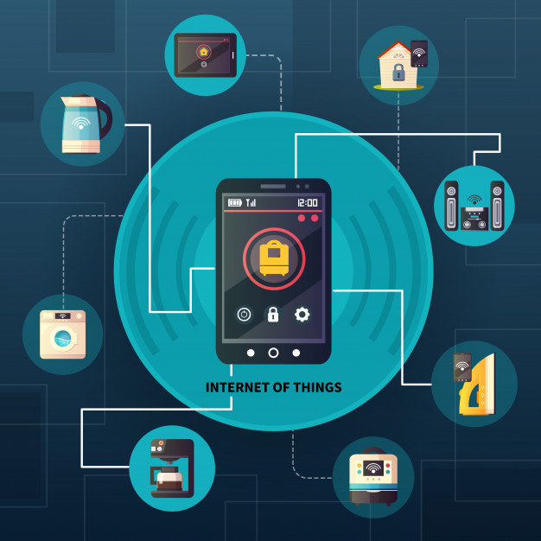
Home Automation:
-Home automation or Domotics is building automation for a home, called a smart home or smart house. A home automation system will monitor and/or control home attributes such as lighting, climate, entertainment systems, and appliances. When connected with the Internet, home devices are an important constituent of the Internet of Things ("IOT").

Slide 4
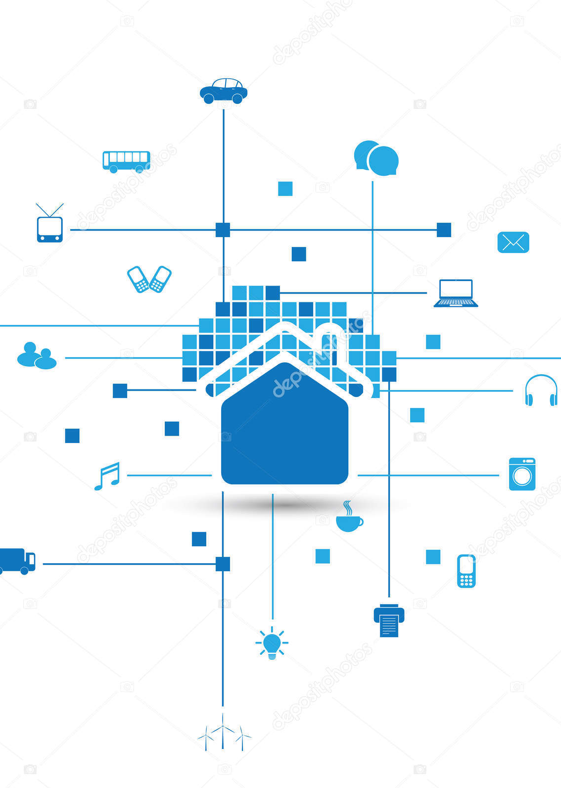
ABSTRACT OF HOME AUTOMATION.
In order to help maintain comfortable living conditions within a home, home monitoring and automation are utilized. The standards of human's comfort in homes can be categorized into several types. Among these categories, the most significant ones are the thermal comfort, which is related to temperature and humidity, followed by the visual comfort, related to colors and light, and hygienic comfort, associated with air quality.
Additionally, making the house smart is to allow for intelligent automatic executing of several commands after analyzing the collected data. Automation can be accomplished by using the Internet of Things (IoT). This gives the inhabitant accesses to certain data in the house and the ability to control some parameters remotely. This paper presents the complete design of an IoT based sensing and monitoring system for smart home automation.

Slide 5

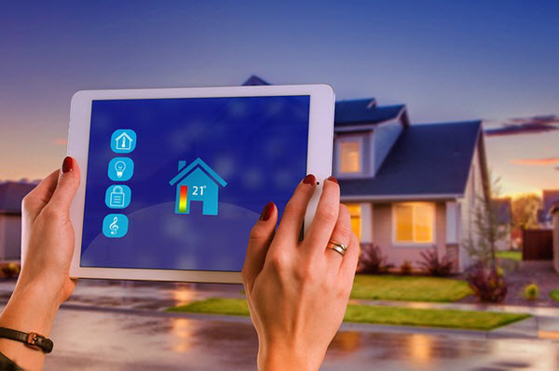
PROBLEM STATEMENT:
Home automation refers to control the home appliances by using computer technology. Home automation provides security, energy efficiency and ease of use hence, it is adopted more. It also provides remote interface to home appliances to provide control and monitoring on a web browser.
The benefits of home automation typically fall into a few categories, including
Savings,
Safety,
Convenience,
Control.

Slide 6
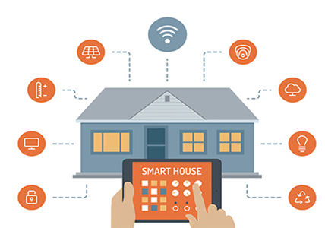
Iot Home Automation: Home Automation Has Three Major Parts: »Hardware » Software/Apps » Communication Protocols
Home Automation Components: » Iot Sensors » Iot Gateways » Iot Protocols » Iot Firmware » Iot Cloud And Databases
Cloud Services Are Divided Into Three Categories:
» Platform As A Services (PaaS),
» Infrastructure As A Services (IaaS),
» And Software As A Service (SaaS).
There Are Numerous Iot Cloud Computing Service Provides Such As:
» AWS Iot
» Azure Iot
» Thingworx
» Thingspeak
» Carriots
» Konekt
» IBM Bluemix
» Blynk Iot

Slide 7
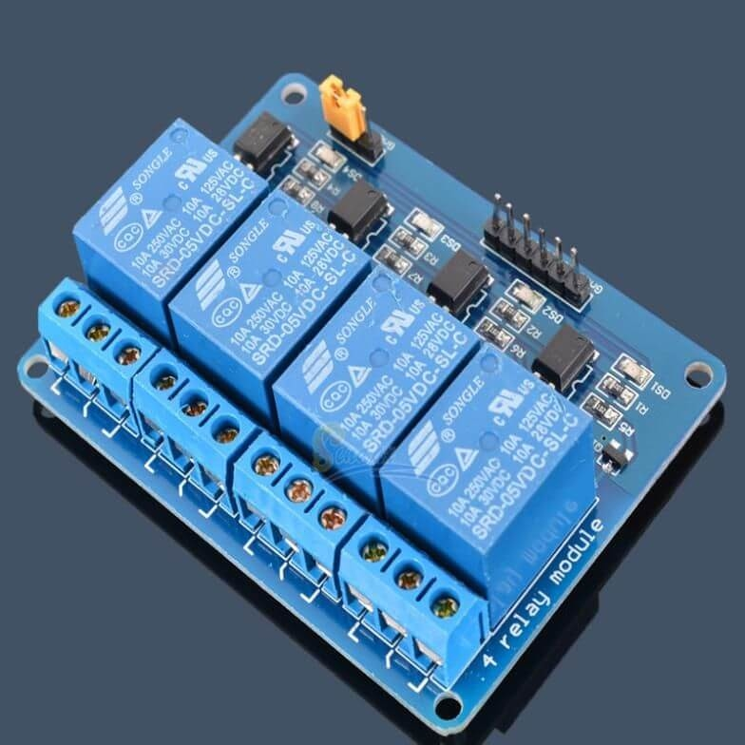
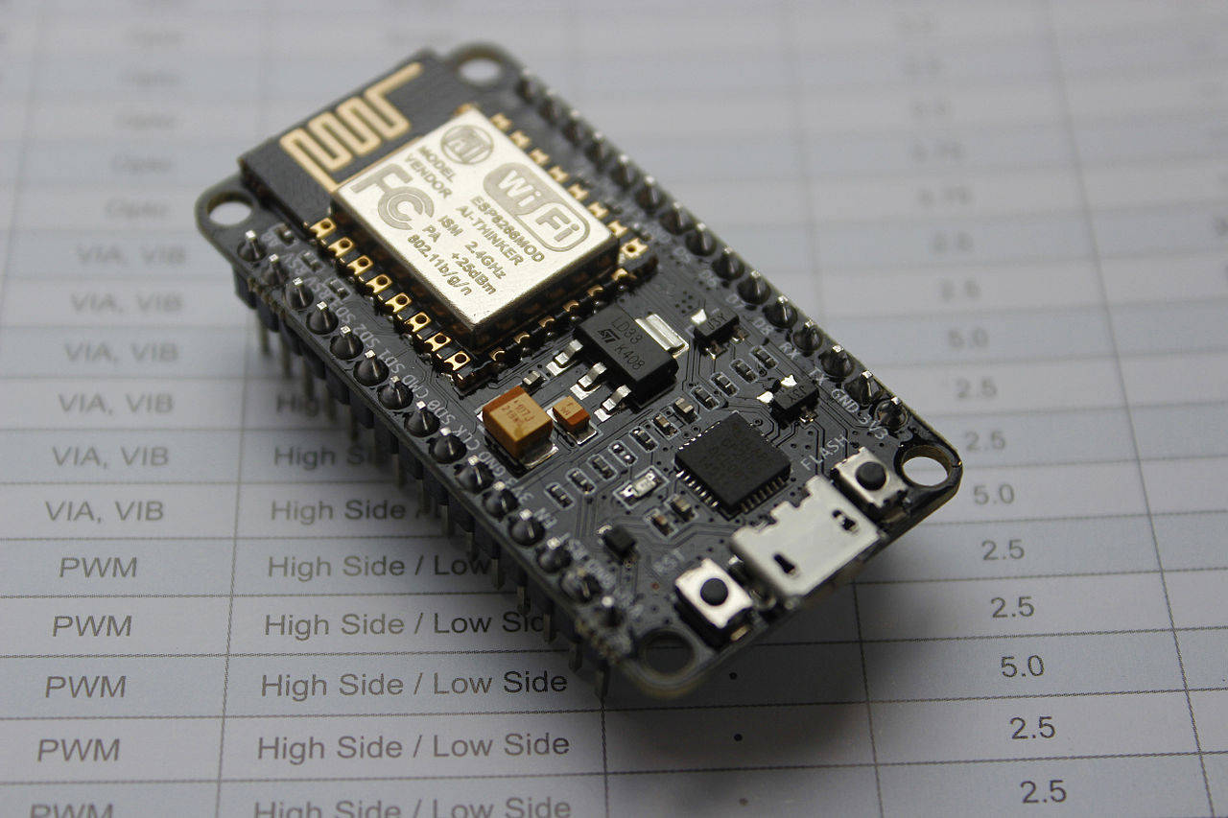
Relay: A Relay is an electrically operated switch. It consists of a set of input terminals for a single or multiple control signals, and a set of operating contact terminals. The switch may have any number of contacts in multiple contact forms, such as make contacts, break contacts, or combinations thereof. MODES: -Normal Open Relay -Normal Close Relay -Double Pole Double Throw Relay
WIFI CONTROL CARD:
NodeMCU is a low-cost open source IoT platform. It initially included firmware which runs on the ESP8266 Wi-Fi SoC from Espressif Systems, and hardware which was based on the ESP-12 module. Later, support for the ESP32 32-bit MCU was added.

Slide 8
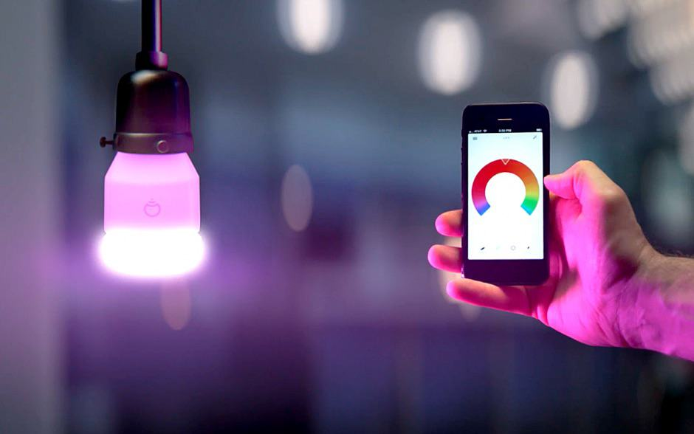
Applications of home automation:
Lighting control
Lawn/Gardening management
Smart Home Appliances
Improved Home safety and security
Home air quality and water quality monitoring
Natural Language-based voice assistants
Better Infotainment delivery
AI-driven digital experiences
Smart Switches
Smart Locks

Slide 9
A home automation system typically connects controlled devices to a central hub or "gateway". The user interface for control of the system uses either wall-mounted terminals, tablet or desktop computers, a mobile phone application, or a Web interface that may also be accessible off-site through the Internet.
LANGUAGE USED : C , Arduino IDE
TOOLS USED : 4 Channel Relay , NodeMCU board , 5 volt DC supply
REFERENCE : Wikipedia and etc….

Slide 10
THANK YOU

